Slide 1
9th Literature & Composition
Harrison High School
April 30, May 1, May 2

Slide 2
When and where will we take the EOC?
Monday – Wednesday| April 30 – May 2
Test during your regularly scheduled class period only
Meet in the lab on the days of your test

Slide 3
What to Bring What NOT to Bring
2+ pencils with erasers
Copy of our class novel
A jacket/sweatshirt
Cell phone (it will be collected)
Food/drink
Excessive “stuff” – bags, binders, etc.
Noisy things

Slide 4
How can I prepare?
Review your grammar practice, EOC vocabulary packet, writing prompts, and teacher feedback on assignments (hint: www.TurnItIn.com!)
Review the EOC practice activity
GET SOME SLEEP!!
Eat a healthy and filling breakfast and/or lunch (depending on your testing period, though it doesn’t hurt to do both regardless)
Use the restroom BEFORE coming to the lab
Hustle to the lab so you have plenty of time to get set up without rushing and getting flustered

Slide 5
Test-Day Procedures
Meet in the assigned lab
Place your backpack and all belongings in the front of the room (or area designated by your teacher) – no food/drinks at your seat!
Turn your cell phone ALL THE WAY OFF, place a sticky note with your name on your phone, and leave it in the box on the teacher desk
Take pencils, a jacket, and a copy of your class novel to your assigned computer
Place your novel under your seat
Write your name on your scratch paper
Log in to the computer but do not log in to the testing program until instructed to do so

Slide 6
Day 1 of the EOC
90 minutes maximum on this day
Definitely includes extended-response (essay), but may also include selected-response items (multiple choice), technology-enhanced items, and constructed-response items
75 minutes maximum each day
Includes selected-response items (multiple choice), technology-enhanced items, and constructed-response items
Technology-enhanced items – Be sure to read the instructions! You will probably have to copy-and-paste evidence from a text.
Days 2 & 3 of the EOC

Slide 7
Norm-Referenced Questions
Some questions may or may not be aligned to Georgia Standards of Excellence. These are called norm-referenced questions. They are items that will yield a national comparison.
Some of these are used for feedback only and will not impact the student’s score on the test.
So…who cares? Well, if you come across a question on the test and have NO IDEA what in the world you are supposed to do, don’t stress. It may be a norm-referenced question, and that is why your teacher “never taught this.” Your teachers teach you the standards, so questions that do not align with standards may not be addressed in your classes.

Slide 8
Selected-Response/Multiple Choice
Some of these questions may ask for more than one answer, so be sure to read the instructions very carefully.
The question may look something like this, except for literature, you should not be asked to select equations. ☺

Slide 9
Don’t forget to use these tools!

Slide 10
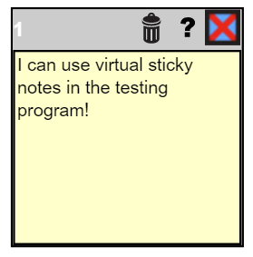
Constructed-Response
Type in this box. Remember that there is no spell check or “auto-corrections.” You must capitalize! Shift + (letter)
Use the tools available to you.
Hmm…maybe I should use my scratch paper to plan my writing…
This is your character count. Use this to gauge how much to write!

Slide 11
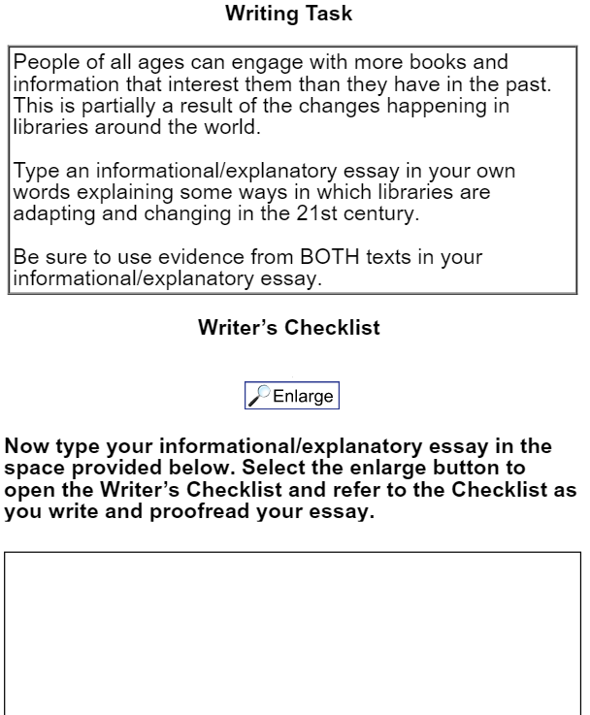
Extended-Response
Type in this box. Remember that there is no spell check or “auto-corrections.” You must capitalize! Shift + (letter)
Use the tools available to you.
Hmm…I should definitely use my scratch paper to plan my writing…
Always click this to get more information about your writing, like a checklist!

Slide 12
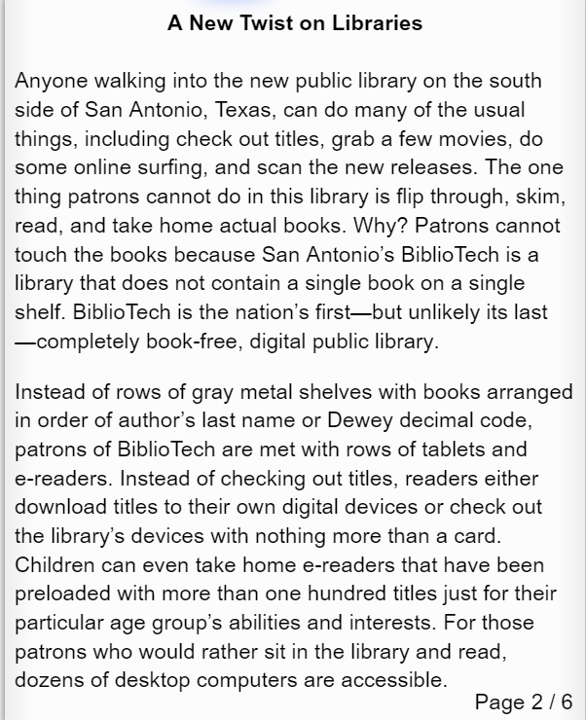
FAQ: How do I cite in my constructed and extended responses?
Use page number when available. If there is no page number, look for a line number.
Example:
The author writes, “San Antonio’s BiblioTech […] does not contain a single book” (2).
If you are using more than one text, be sure to indicate in your parenthetical citation which text you are using.
Example:
The author writes, “San Antonio’s BiblioTech […] does not contain a single book” (“A New Twist on Libraries” 2).

Slide 13
FAQ: How do I cite in my constructed and extended responses?
The most important thing to remember when citing…
The evaluators want to see that you are making an effort to give credit to the author!
Use page number when available. If there is no page number, look for a line number.
Example:
The author writes, “San Antonio’s BiblioTech […] does not contain a single book” (2).
If you are using more than one text, be sure to indicate in your parenthetical citation which text you are using.
Example:
The author writes, “San Antonio’s BiblioTech […] does not contain a single book” (“A New Twist on Libraries” 2).

Slide 14
Three Types of Writing on the EOC: Argumentative, Informational/Explanatory, and Narrative
Sometimes the prompt will tell you what to write. Example:
Other times, you’ll need to figure it out!
Sample argument: Explain how the author develops the theme that home is a joyful and safe place. Use details from the text to support your answer.
Another argument: Which author MOST successfully develops the topic according to his/her purpose using valid reasoning and relevant evidence?
Sample narrative: Using information from the text, write an introduction to a short story that will feature a dragon or dragons. Be sure your introduction establishes the story’s setting, point of view, and primary conflict. Write your answer on the lines provided.

Slide 15
Motsinger’s Last-Ditch Effort to Teach You These Things
You must use lead-ins. DO NOT begin a sentence with a quote without giving your reader some context.
Make an effort to cite your evidence. Use whatever you can find: author, page number, line number, article title, etc.
Capitalize the first letter of each sentence, each proper noun, and each pronoun “I.”
Avoid contractions in formal writing, like the EOC! If you must use a contraction (in a line of dialogue in a narrative, for example), be sure to use your apostrophe!
“Alot” is not a word, and “a lot” should not be used anyway! Find a more descriptive word or phrase.

Slide 16
EOC Practice Test
In Google Chrome ONLY, go to http://www.gaexperienceonline.com/.
Click “Test Practice.”
Click “End of Couse (EOC) Winter, Spring, Summer Main – Online Tools Training.”
Click “EOC Test Practice.”
Click “Standard Online Tools.”
Log in with the credentials provided and complete the test practice.

